Slide 1
MC/DC

Slide 2
MC/DC
MC/DC is a structural coverage that ensures:
  That decisions take true and false values
  That conditions are exercised independently
If ( A or C ) ➔ “A or C” is the decision, “A” & “C” are the conditions
The independence is also called the “unique cause”, but it cannot be always shown due to masking problem
  There is a way to resolved it

Slide 3
The 5 steps method (Nasa)
Create a representation of the source/logic
Indentify the test inputs from requirements-based tests
Eliminate masked test case
Determine MC/DC based on blocks specificities (And, or, if, …)
Examine outputs of the tests to confirm correct operation

Slide 4
The And Gate
a
c
b

Slide 5
The And Gate
a
1
T
T
1
T
c
b

Slide 6
The And Gate
a
1 2
T F
T T
1 2
T F
c
b

Slide 7
The And Gate
a
1 2 3
T F F
T T F
1 2 3
T F F
c
b

Slide 8
The And Gate
a
1 2 3 4
T F F T
T T F F
1 2 3 4
T F F F
c
b

Slide 9
Minimun Set of Test
a
1 2 3 4
T F F T
T T F F
1 2 3 4
T F F F
c
b

Slide 10
Or Gate : Minimun Set of Test
a
1 2 3
F F T
F T F
1 2 3
F T T
c
b

Slide 11
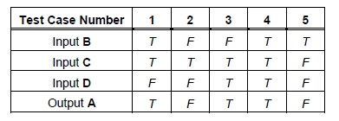
Example of logic, with its inputs from req

Slide 12
Reporting tests
1 2 3 4 5
T F F T T
T T T T F
1 2 3 4 5
T F F T F
F F T T F
1 2 3 4 5
T F T T F

Slide 13
Identifying masked case
1 2 3 4 5
T F F T T
T T T T F
1 2 3 4 5
T F F T F
F F T T F
1 2 3 4 5
T F T T F

Slide 14
Determination of MC/DC : AND
1 2 3 4 5
T F F T T
T T T T F
1 2 3 4 5
T F F T F
F F T T F
1 2 3 4 5
T F T T F
Unmasked case provide MC/DC for “AND”

Slide 15
Determination of MC/DC: OR
1 2 3 4 5
T F F T T
T T T T F
1 2 3 4 5
T F F T F
F F T T F
1 2 3 4 5
T F T T F
Case 1, 3 and 2 or 5 provide MC/DC for “OR”

Slide 16
Output confirmation
1 2 3 4 5
T F F T T
T T T T F
1 2 3 4 5
T F F T F
F F T T F
1 2 3 4 5
T F T T F
Case 1, 2, 3 satisfy MC/DC.
Test 4 doest not contribute

Slide 17
Using Expressions
a
X > 30
c
b
Test Case | Condition
X = 30 | F
X = 31 | T
X = 0 | F
X = 100 | T
…

Slide 18
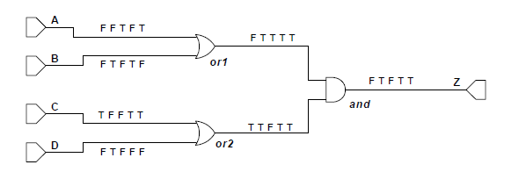
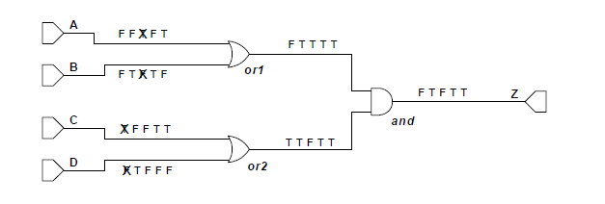
Unique Cause vs Masking

Slide 19
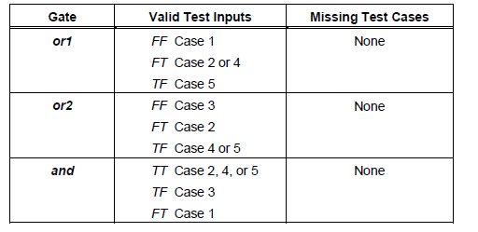
MC/DC of gates
There is no missing tests

Slide 20
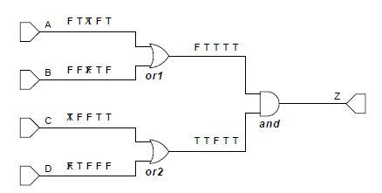
Changing test case: impact
Changing test case 2 from FTFT to TFFT

Slide 21
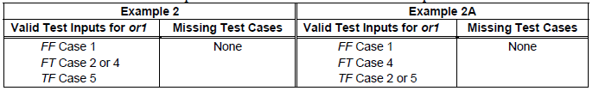
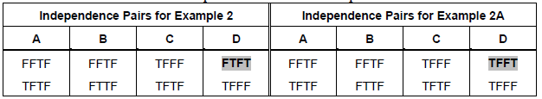
Result
In Ex 2A, only D changes, while in Ex 2, A & B also changes
Either “unique cause” or “masking” approaches detects the same errors
Notes:
2nd table shows input vectors where there is independence of variable. Ex:
A: FFTF and TFTF => only A varies.
With example 2 when D varies, A & B also varies => no more unique cause, due to masking.
But actually, unique-cause & masking reveal the same error.

Slide 22
Black-Box Testing
What if black-box testing ?
  That is, not visibility on the code
Then :
  Either the requirements are sufficiently explicit & close to the code, that is: the requirements and code represent exactly the same logical function ➔ OK
  There is a difference. In which case, you need to ask help from dev, knowing that they should not provide exactly the example or the logic…
Notes:
Note: structural coverage is a measure
Structural coverage starts from requirements, structural-testing from code !
Statement coverage: the weakest. With a test, one can cover a statement, but we can miss the fact to coded-bool expr is wrong. For if with simple-branch, we miss also the « else ».

